Slide 1
Lecture 8: Market Equilibrium
ECO101: Introduction to microeconomics
Fall 2020
BRAC University

Slide 2
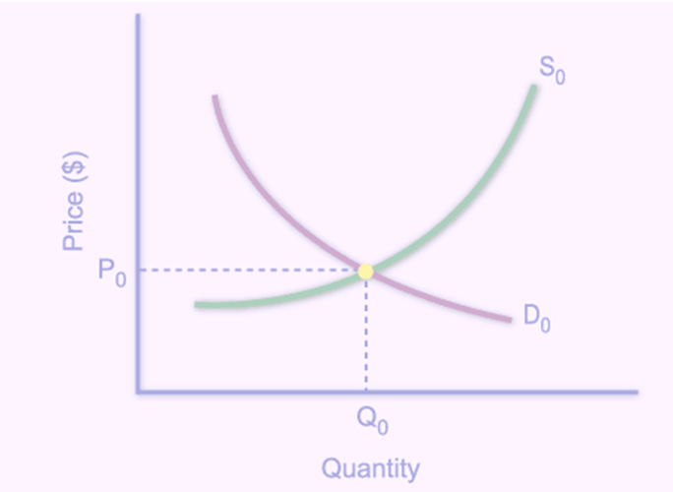
Market Equilibrium
The market equilibrium price is the price at which the quantity demanded equals the quantity supplied.
The market equilibrium quantity is the quantity bought and sold at the equilibrium price.

Slide 3
Market Equilibrium
Quantity Quantity Shortage(–)
Price demanded supplied or surplus(+)
(dollars of bars) (millions of bars per week)
0.50 22 0 –22
1.00 15 6 –9
1.50 10 10 0
2.00 7 13 +6
2.50 5 15 +10

Slide 4
Market Equilibrium
3.00
Supply
Price
2.50
2.00
1.50
1.00
Demand
.50
0 5 10 15 20
Quantity

Slide 5
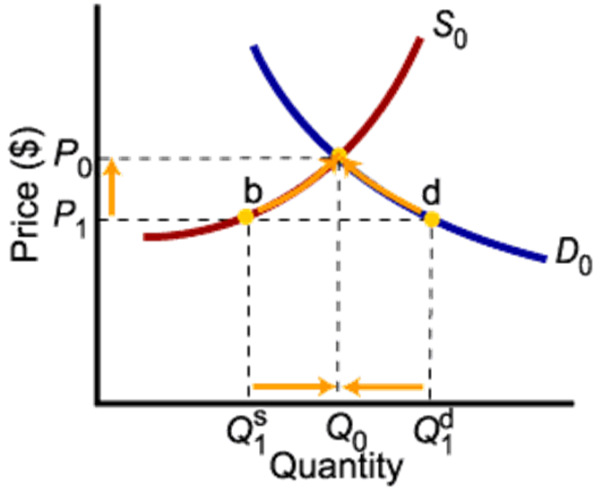
Market Disequilibria: Shortages
If the price is too low, the quantity demanded exceeds the quantity supplied. People are willing to pay more for the good.
To eliminate this shortage, sellers will raise the price, increasing the quantity supplied and reducing the quantity demanded.

Slide 6
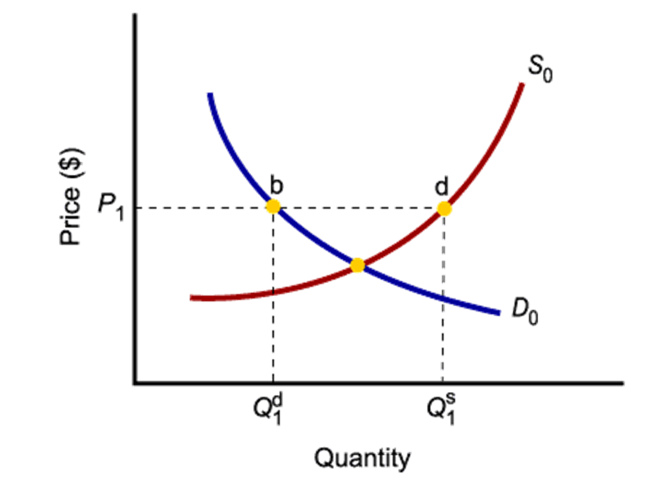
Market Disequilibria: Surpluses
If the price is too high, the quantity supplied exceeds the quantity demand. Inventories pile up.
To eliminate this surplus, sellers will lower the price, reducing quantity supplied and increasing quantity demanded.

Slide 7
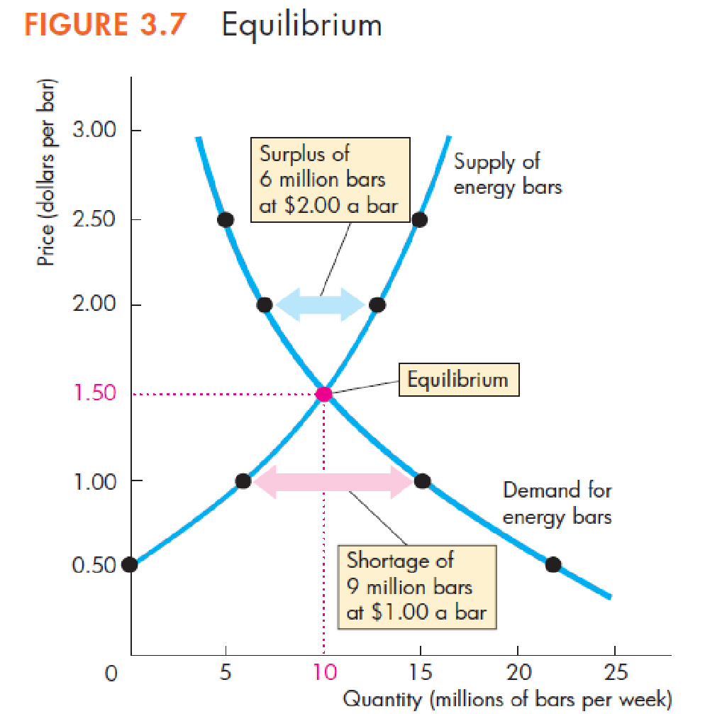
A Shortage Forces the Price Up
If demand exceeds supply, sellers will raise price, decreasing quantity demanded.
A Surplus Forces the Price Down
If supply exceeds demand, sellers will see their inventories of unsold goods piling up and will cut price to sell them.

Slide 8
Lecture 9: Predicting changes in Market Equilibrium
ECO101: Introduction to microeconomics
Fall 2020
BRAC University

Slide 9
Predicting Changes in Price and Quantity
A change in price and quantity must be caused by either a change in demand or a change in supply or both!

Slide 10
Demand Increases if:
Demand Decreases if:
■ The price of a substitute rises
■ The price of a complement falls
■ The expected future Price or income rises
■ Income rises*
■ No of consumer/ population increases
*considering normal goods
■ The price of a substitute falls
■ The price of a complement rises
■ The expected future Price or income falls
■ Income falls*
■ No of consumer/ population decreases
*considering normal goods

Slide 11
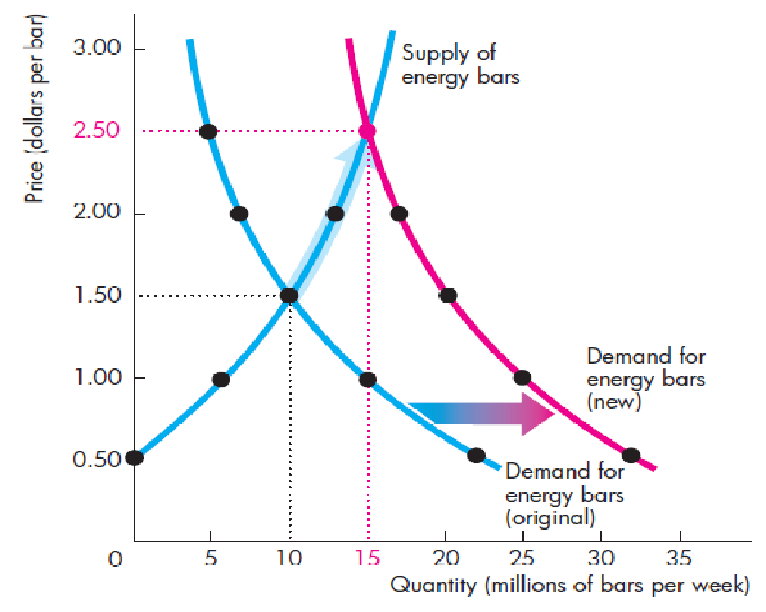
Effect of An Increase in Demand on Equilibrium Price and Quantity
An increase in demand shifts the demand curve to the right (outward shift in demand).
The new equilibrium price and quantity are higher.

Slide 12
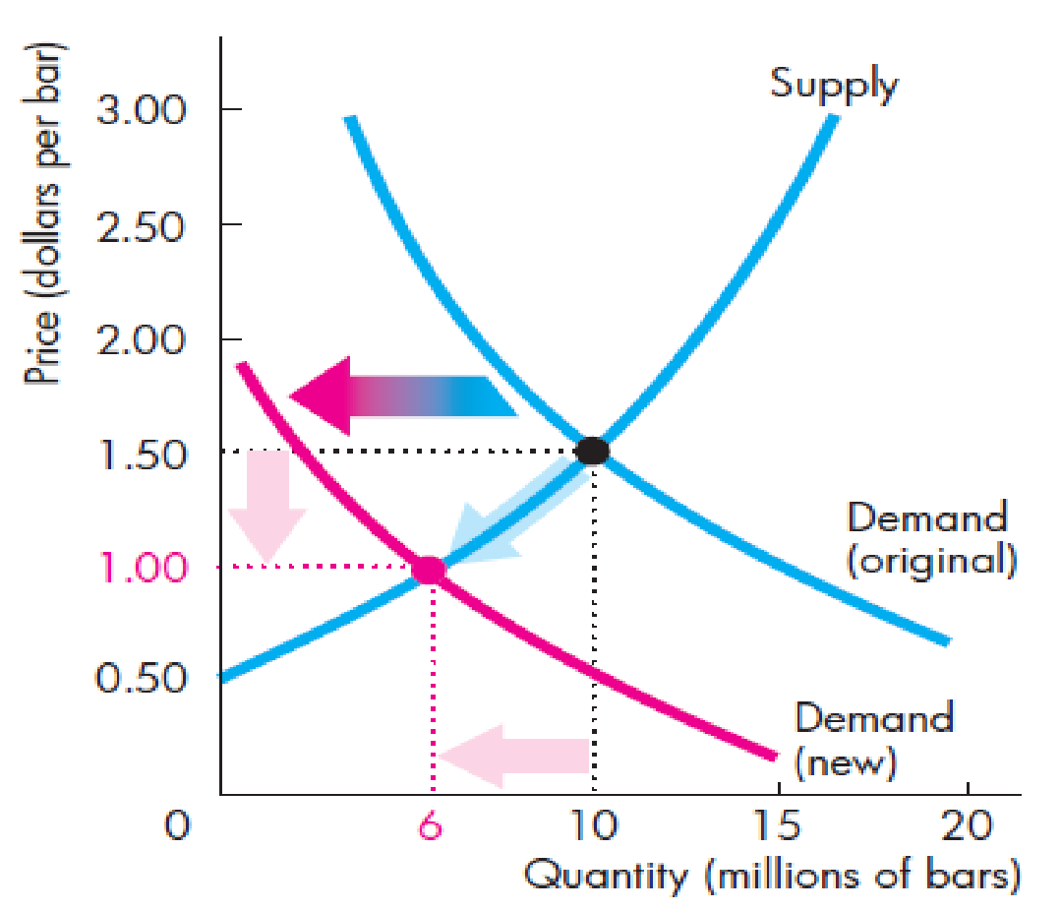
Effect of A decrease in Demand on Equilibrium Price and Quantity
A decrease in demand shifts the demand curve to the left (inward shift in demand).
The new equilibrium price and quantity are lower.

Slide 13
Supply Increases if:
Supply Decreases if:
■ The price of a factor of production (input price, technology) rises
■ Unfavorable govt. policy
■ The expected future price falls
■ The number of suppliers of bars increases
■ The price of a substitute in production rises
■ The price of a complement in production falls
■ A unfavorable natural event decreases production
■ The price of a factor of production (input price, technology) falls ■ Favorable govt. policy
■ The expected future price falls
■ The number of suppliers of bars increases
■ The price of a substitute in production falls
■ The price of a complement in production rises
■ A favorable natural event increases production

Slide 14
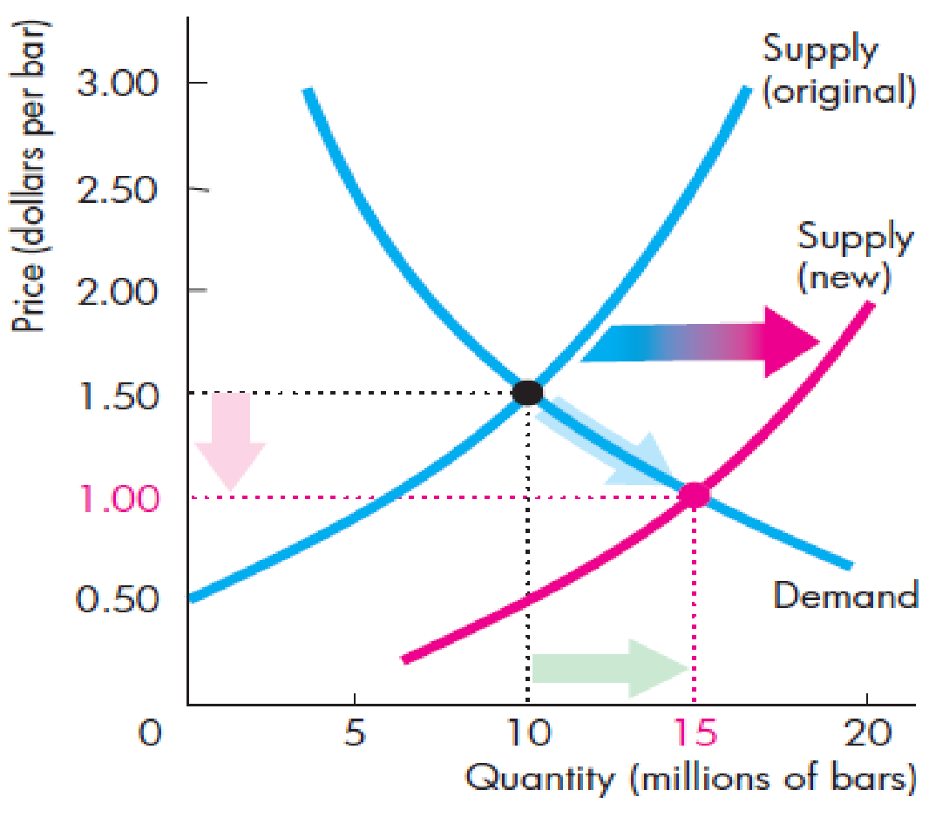
Effect of An Increase in Supply on Equilibrium Price
An increase in supply shifts the supply curve to the right (outward shift in supply).
The new equilibrium price is lower, but the equilibrium quantity is higher.

Slide 15
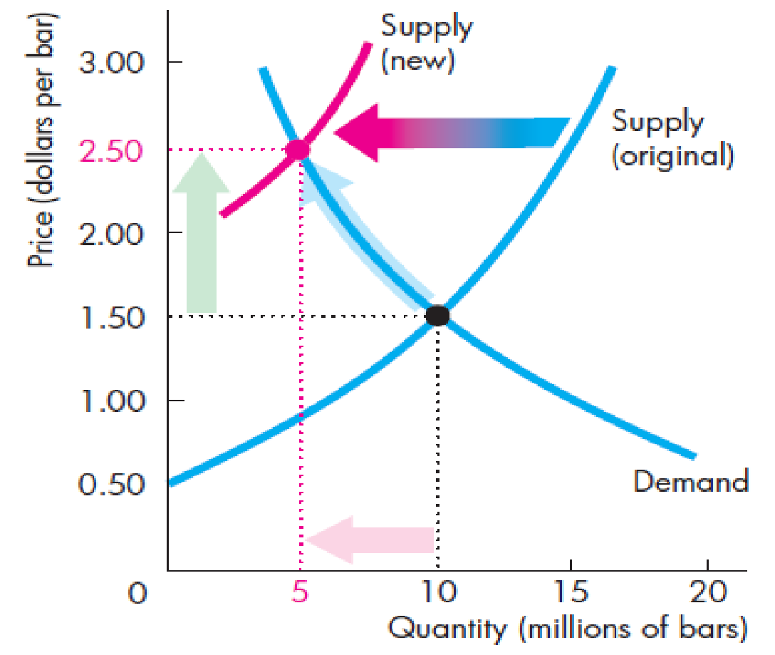
Effect of An Decrease in Supply on Equilibrium Price
A decrease in supply shifts the supply curve to the left (inward shift in supply).
The new equilibrium price is higher, but the equilibrium quantity is lower.

Slide 16
A Change in Both Demand and Supply
There are four possible scenarios-
Both demand and supply increase
Both demand and supply decrease
Demand increases and supply decreases
Demand decreases and supply increases
Effects-
Both curves shift.
Price and quantity change will depend on how each curve shifts on which direction.

Slide 17
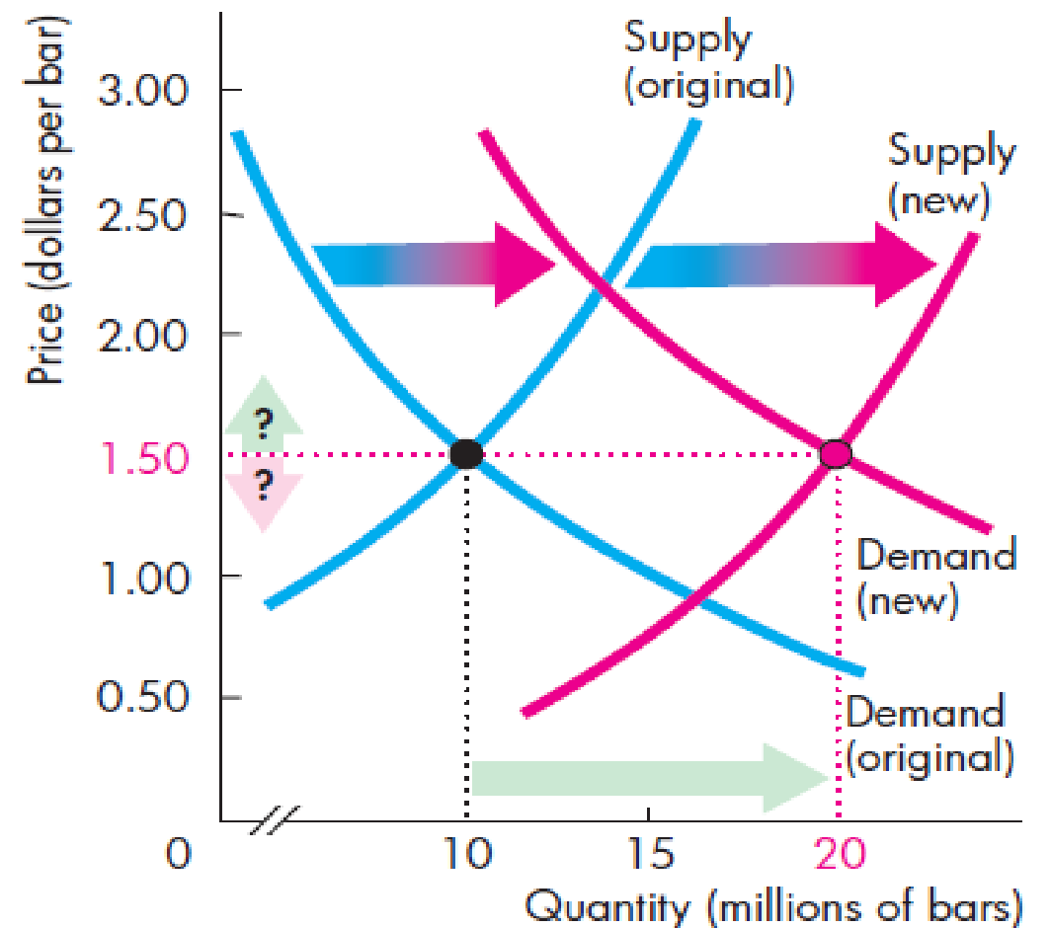
1. Both demand and supply increase
If demand and supply increase, both the demand and supply curves shift to the right (outward).
Effect on equilibrium price and quantity
The new equilibrium quantity will be higher.
The new equilibrium price may be higher, lower, or it may remain the same.

Slide 18
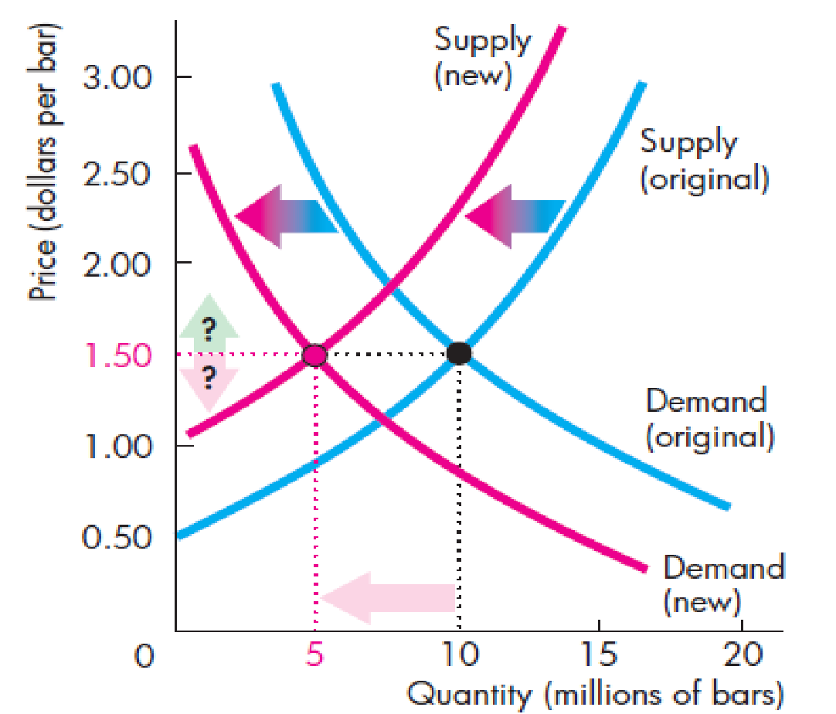
2. Both demand and supply decrease
If demand and supply decrease, both the demand and supply curves shift to the left (inward).
Effect on equilibrium price and quantity
The new equilibrium quantity will be lower.
The new equilibrium price may be higher, lower, or it may remain the same.

Slide 19
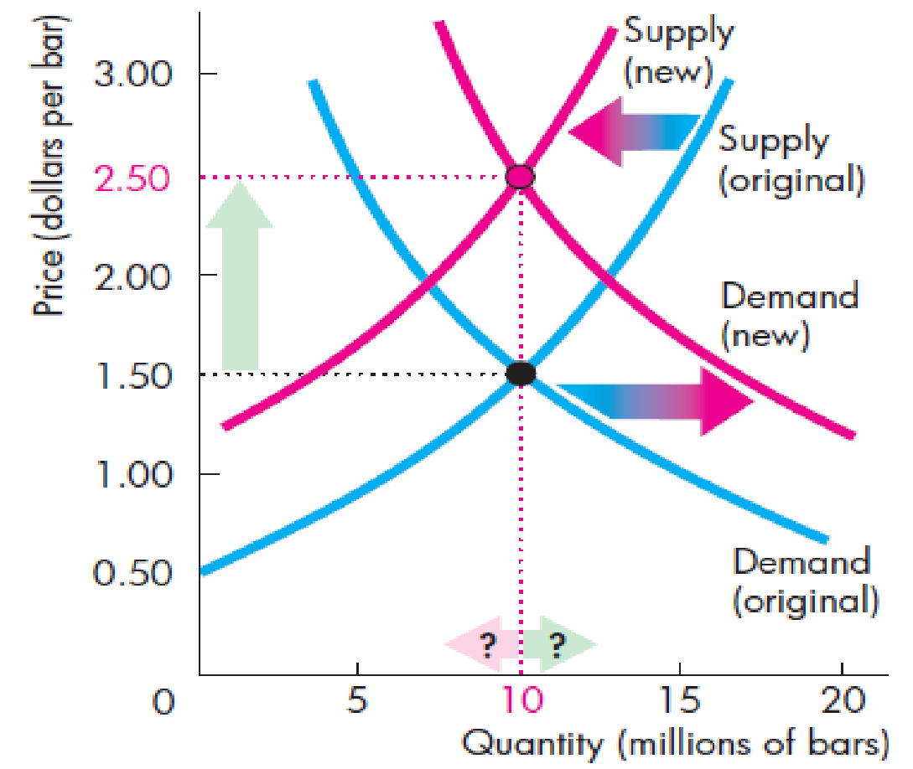
3. Demand increases and supply decreases
When demand increases, demand curve shifts to the right (outward).
When supply decreases, supply curves shift to the left (inward).
Effect on equilibrium price and quantity
The new equilibrium price will be higher.
The new equilibrium quantity may be higher, lower, or it may remain the same.

Slide 20
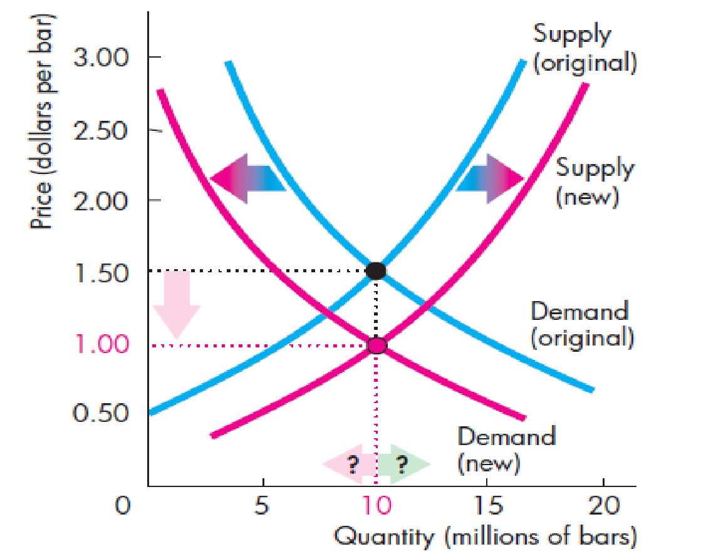
4. Demand decreases and supply increases
When demand decreases, demand curve shifts to the left (inward).
When supply increases, supply curves shift to the right (outward).
Effect on equilibrium price and quantity
The new equilibrium price will be lower.
The new equilibrium quantity may be higher, lower, or it may remain the same.

